Slide 1

Customer Shopping Behavior Analysis
Uncovering insights from 3,900 purchases to guide strategic business decisions.

Slide 2

Project Overview & Dataset Summary
Project Goal
Key Data Features
Analyze 3,900 purchases to uncover spending patterns, customer segments, and product preferences.
18 columns including demographics, purchase details, and shopping behavior (e.g., Subscription Status, Purchase Amount, Category).
Data Note
37 missing values in the Review Rating column were imputed using the median rating per category.

Slide 3


Exploratory Data Analysis (Python)
Data Preparation Steps
Loading & Exploration
Imported dataset; checked structure and summary statistics.
Handling Missing Data
Imputed Review Rating using median by product category.
Standardization
Renamed columns to snake_case for readability.
Feature Engineering
Created age_group and purchase_frequency_days columns.

Slide 4
Key Business Insights: Revenue & Spending
$157,890
$75,191
$60.48
$58.46
Male Revenue
Female Revenue
Express Shipping Avg. Spend
Standard Shipping Avg. Spend
Total revenue generated by male customers.
Total revenue generated by female customers.
Average purchase amount for Express shipping users.
Average purchase amount for Standard shipping users.
Male customers generate significantly higher total revenue, and Express shipping users show a slightly higher average spend.

Slide 5

Subscriber vs. Non-Subscriber Behavior
Non-subscribers account for the majority of customers and total revenue, but average spend is comparable.
Non-Subscribers (No)
2,847 customers with an average spend of $59.87 and $170,436 total revenue.
Key Finding: 958 repeat buyers (>5 purchases) are subscribers, suggesting loyalty programs could boost subscription rates.
Subscribers (Yes)
1,053 customers with an average spend of $59.49 and $62,645 total revenue.

Slide 6
Product Performance: Ratings and Discounts
Top 5 Products by Average Rating
Top 5 Discount-Dependent Products
Gloves (3.86)
Products with the highest percentage of discounted purchases.
Sandals (3.84)
Boots (3.82)
Hat (50.00%)
Hat (3.80)
Sneakers (49.66%)
Skirt (3.78)
Coat (49.07%)
Sweater (48.17%)
Pants (47.37%)
Note: The Hat is both highly rated and the most discount-dependent product.

Slide 7

Customer Segmentation by Purchase History
Returning — 701
Loyal — 3,116
New — 83
The majority of the customer base falls into the Loyal segment, indicating strong retention, but there is a small base of New customers to grow.

Slide 8
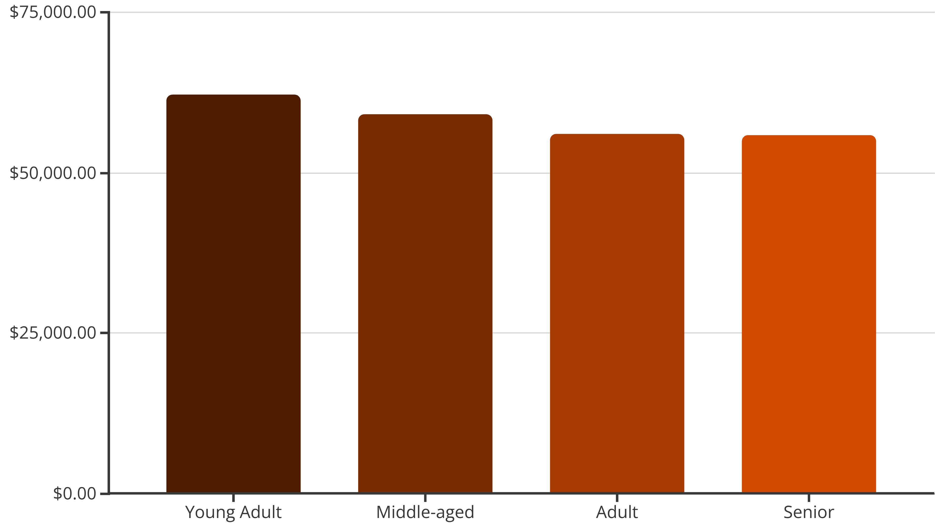
Revenue Contribution by Age Group
Young Adults generate the highest total revenue, followed closely by Middle-aged customers. These are the highest-value segments for targeted marketing.

Slide 9
Top Products Across Categories
Accessories
Clothing
Footwear
Outerwear
Jewelry, Sunglasses, Belt
Blouse, Pants, Shirt
Sandals, Shoes, Sneakers
Jacket, Coat
These are the most purchased products within each major category, indicating core inventory focus areas.

Slide 10

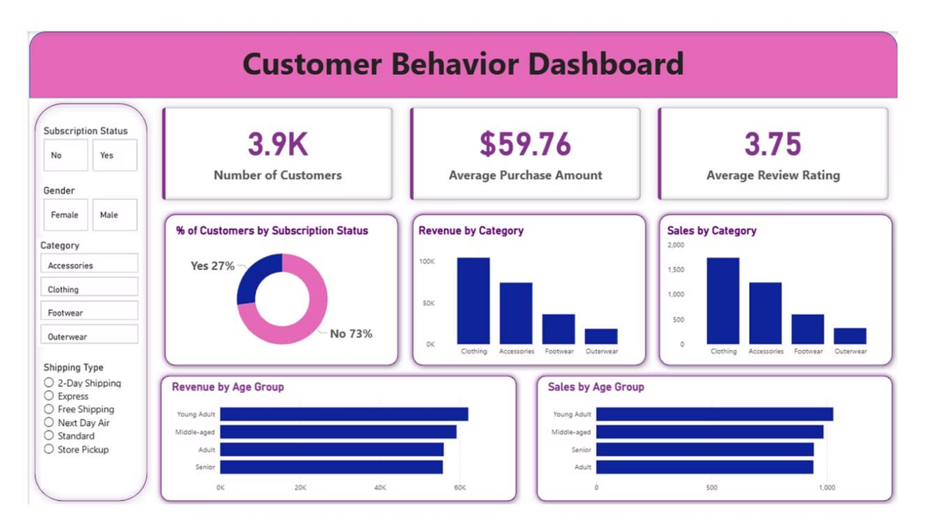
Strategic Business Recommendations
Boost Subscriptions
Promote exclusive benefits to increase subscriber base, especially among repeat buyers.
Enhance Loyalty
Implement programs to move Returning customers into the Loyal segment.
Review Discount Policy
Balance sales boosts with margin control, especially for discount-dependent products like Hats and Sneakers.
Targeted Marketing
Focus campaigns on high-revenue age groups (Young Adult, Middle-aged) and Express shipping users.

